Slide 1
2026-2027
FAFSA Update
Aaron Lemon-Strauss, FSA
MorraLee Keller, NCAN

Slide 2
Fafsa NCAN update
August 14, 2025
CUI//SP-PROCURE//FED ONLY
NOTIONAL - DELIBERATIVE - PRE-DECISIONAL - NOT TO BE SHARED OUTSIDE OF THE DEPARTMENT

Slide 3
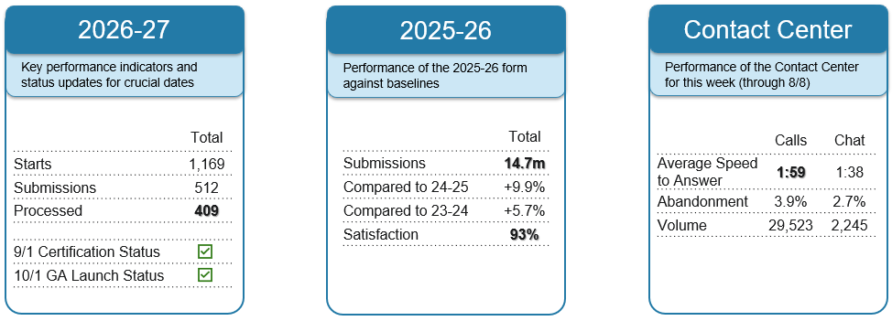
FAFSA Dashboard

Slide 4
2026-27 FAFSA Form Updates

Slide 5
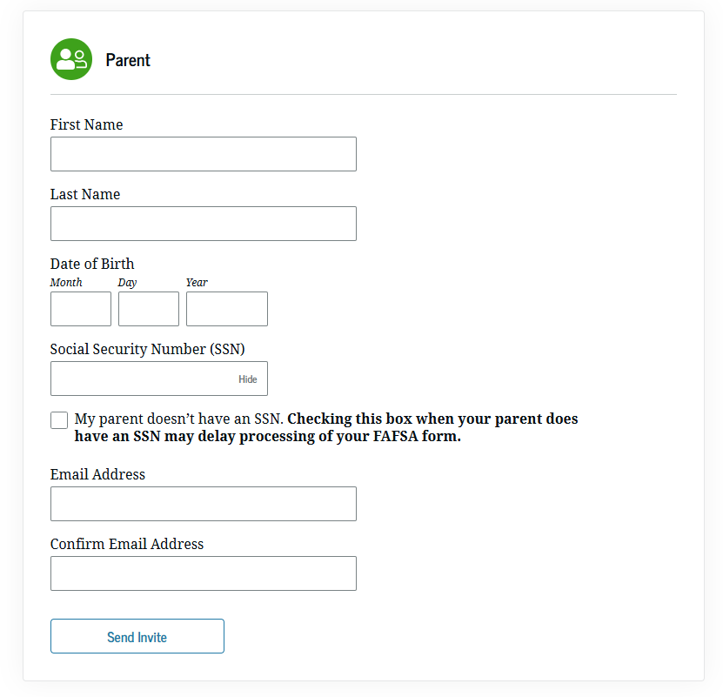
Big move #1: A new contributor flow
Current State ☹
NOTIONAL - DELIBERATIVE - PRE-DECISIONAL - NOT TO BE SHARED OUTSIDE OF THE DEPARTMENT

Slide 6
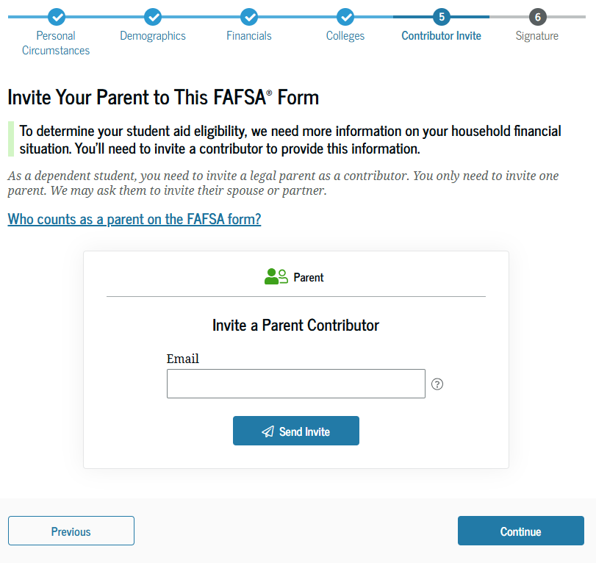

Slide 7
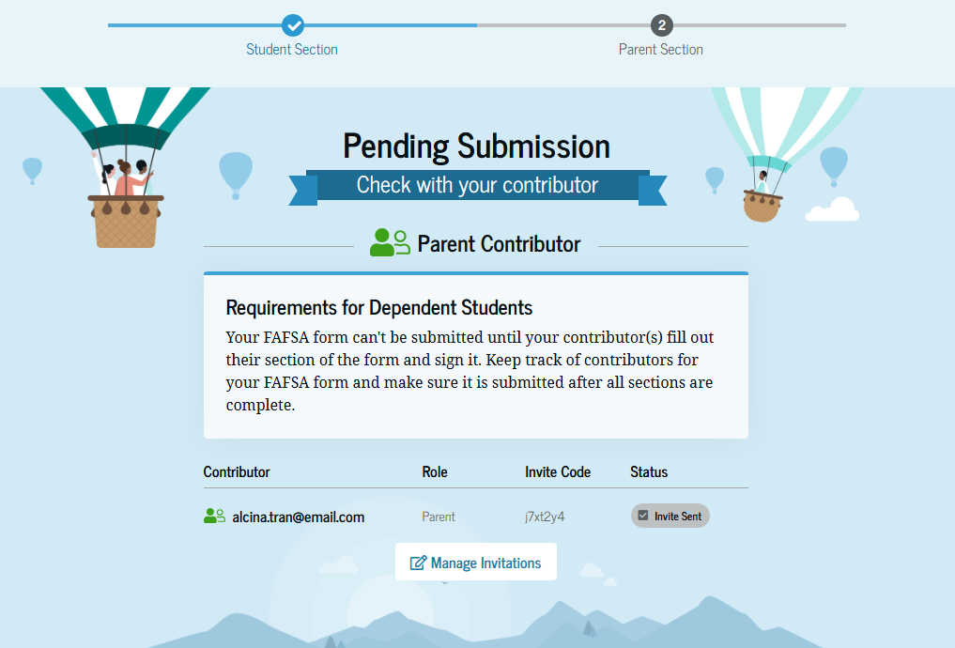

Slide 8
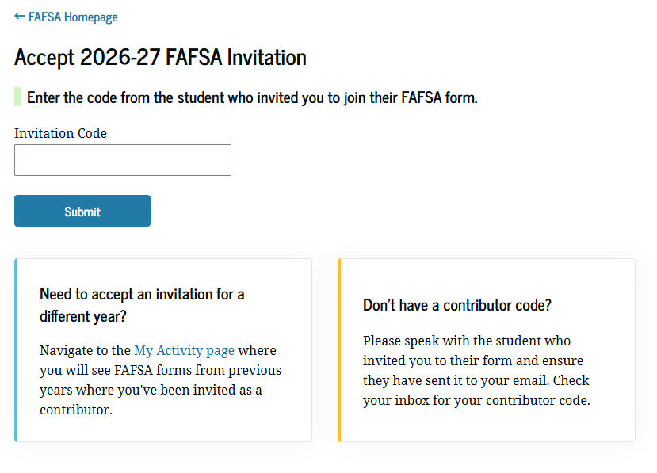
The new flow only applies if the student starts the form.

Slide 9


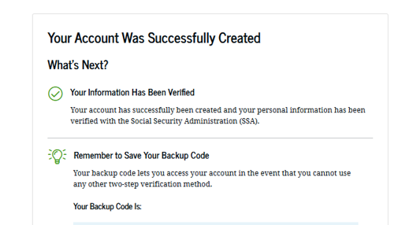




Big move #2: real-time SSA match
NOTIONAL - DELIBERATIVE - PRE-DECISIONAL - NOT TO BE SHARED OUTSIDE OF THE DEPARTMENT

Slide 10
2026-27 beta testing

Slide 11


What are beta events and why are we doing them?
Beta testing is an early release of the 2026–27 FAFSA form for a limited group of students and institutions. This is an industry best practice in software deployment.
Goals
Identifying bugs and squashing them! |  | Prior to Beta events, our team will have thoroughly tested the 26-27 FAFSA form. However, orgs may still encounter issues that we haven't caught. We will have a technical team on call during events for analysis if students encounter a critical issue that prevents them from completing the form. We will also be documenting and collecting issues that come up.
Improving the FAFSA for next cycle |  | Observing real students and families filling out their FAFSA at beta events is one of the best ways for our designers and engineers to identify and prioritize improvements on the form. We have a new contributor invite process thanks in part to beta participants last year!

Slide 12
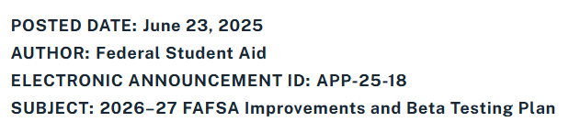
FAFSA forms submitted during beta = FAFSA forms submitted after October 1
Completing the FAFSA form during the beta will result in the same aid process as completing it after general availability.
Beta participants do not have any advantage or disadvantage compared to students who complete the form during general availability.
Most IHEs will wait to download ISIRs until October. We are working with a small set of IHEs during beta to test ISIR processing and delivery.
Electronic Announcement on the Knowledge Center has more detail and guidance for institutions

Slide 13
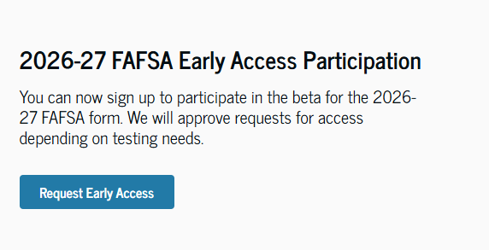
2026-27 FAFSA Beta Key Milestones
We’d love your help to spread the word about Beta 2!
August 4th: Beta 1 Opens
  Events with a limited set of community-based organizations, districts, institutions
  Validate ISIR delivery with local IHEs and vendors
By September 1st: Beta 2 Opens
  Anyone can request access to the 2026-27 Beta FAFSA form on StudentAid.gov
  Continued testing with institutions and vendors
By October 1: General Release

Slide 14
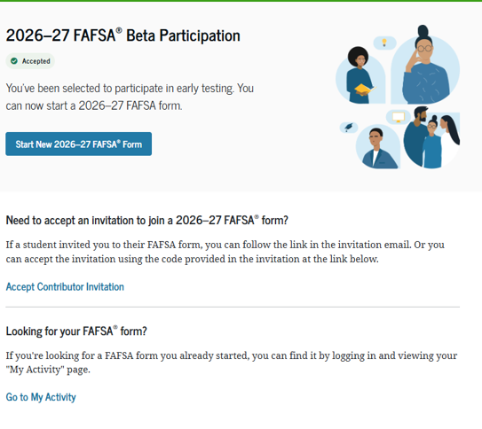
Additional Information on Beta 2
By September 1, we will open Beta testing online. Anyone can request to participate.
To sign up, students and families can complete a brief form to request access found on StudentAid.gov.
We will grant access to randomly selected groups of students throughout the month. Users will receive an email notifying them when they've been admitted.

Slide 15
Questions- just a few

Slide 16
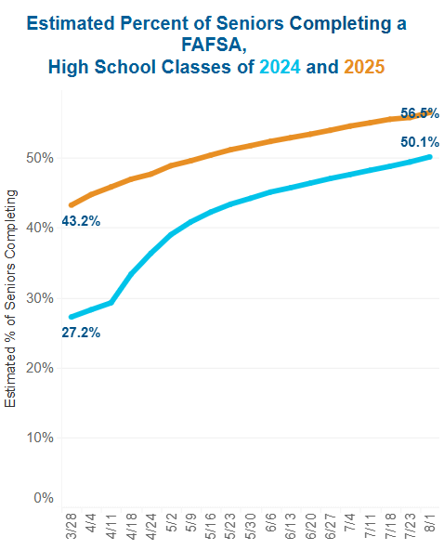
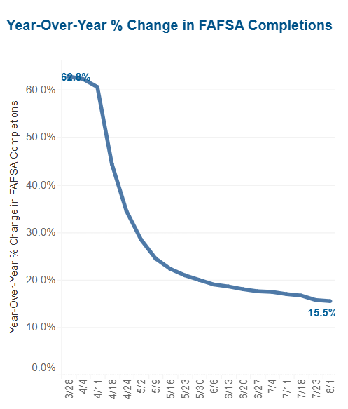
NATIONAL FAFSA NUMBERS – UP 15.5% - TIME TO CELEBRATE

Slide 17
Dependent Student

Slide 18
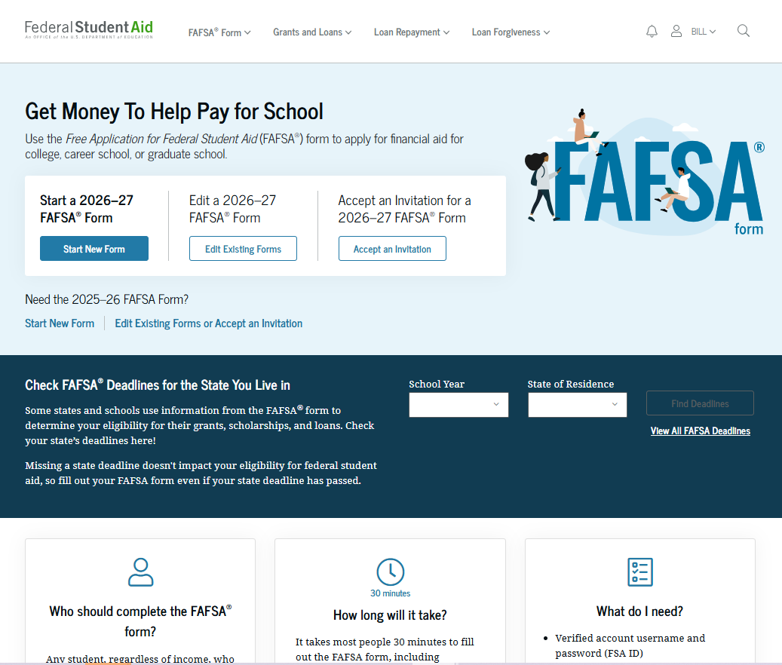
Dependent Student: FAFSA® Landing Page
This is the main FAFSA® landing page. On this page, students are directed to "Start New Form," "Edit Existing Forms," or "Accept an Invitation." For this section of the presentation, the student is beginning a new application.

Slide 19
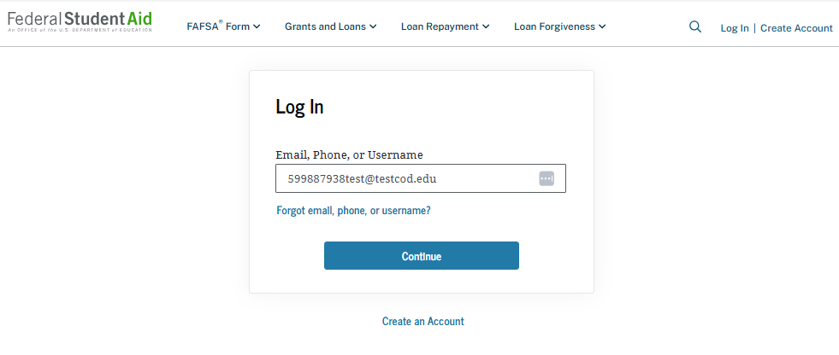
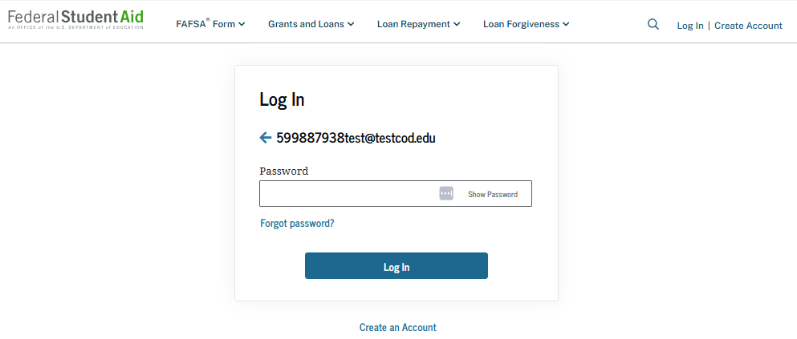
Dependent Student: Log-in
If the student selects "Start New Form" from the FAFSA® landing page and they are not logged in to StudentAid.gov, the student is taken to the "Log In" page to enter their credentials. To access the FAFSA form, all students are required to have a StudentAid.gov account username and password. If the student doesn't have a username and password, they can select "Create an Account."

Slide 20
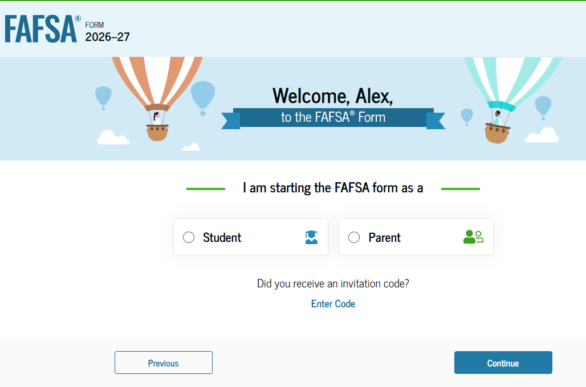
Dependent Student: Roles
After logging in, the student can select the applicable role to fill out the FAFSA® form: "Student" or "Parent." The student also has the option to "Enter Code" if they received an invitation code. The student selects "Student."

Slide 21
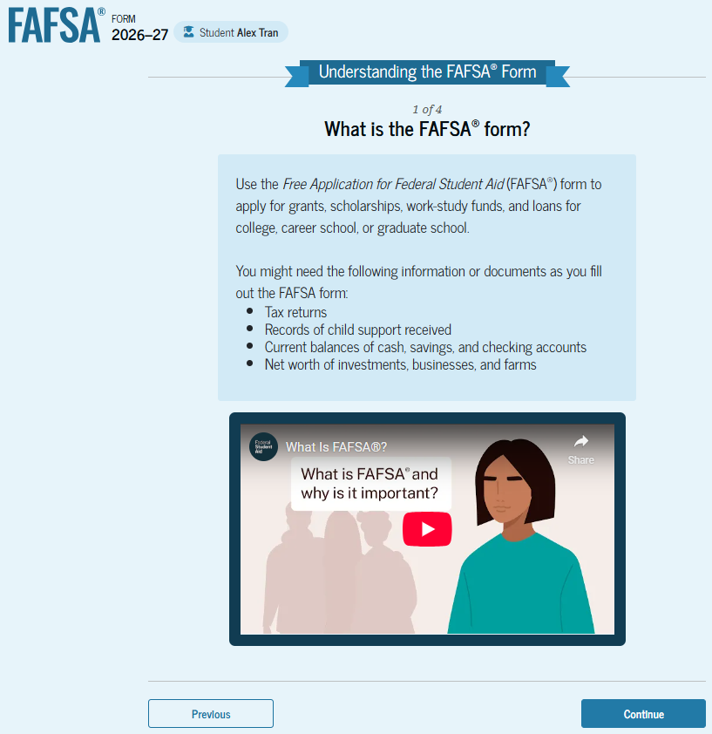
Dependent Student: Onboarding (1 of 4)
When the student starts the 2026–27 FAFSA® form for the first time, they are taken through the FAFSA onboarding process. The first onboarding page provides an introduction of the FAFSA form and an accompanying video. Documents that may be needed to fill out the form are also included on this page.

Slide 22
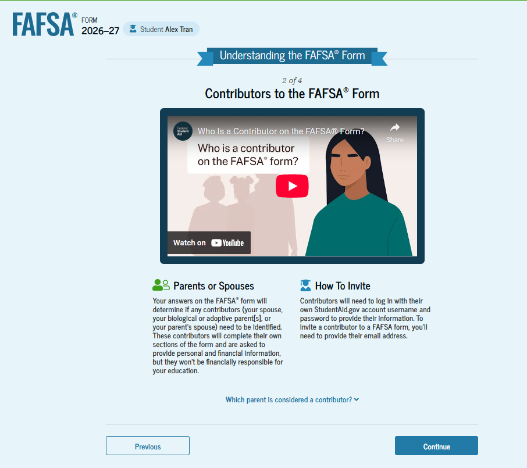
Dependent Student: Onboarding (2 of 4)
The second FAFSA® onboarding page provides information and a video about contributors who may be required to participate on the student’s FAFSA form. This page also provides information on how the student will invite contributors to the FAFSA form.

Slide 23
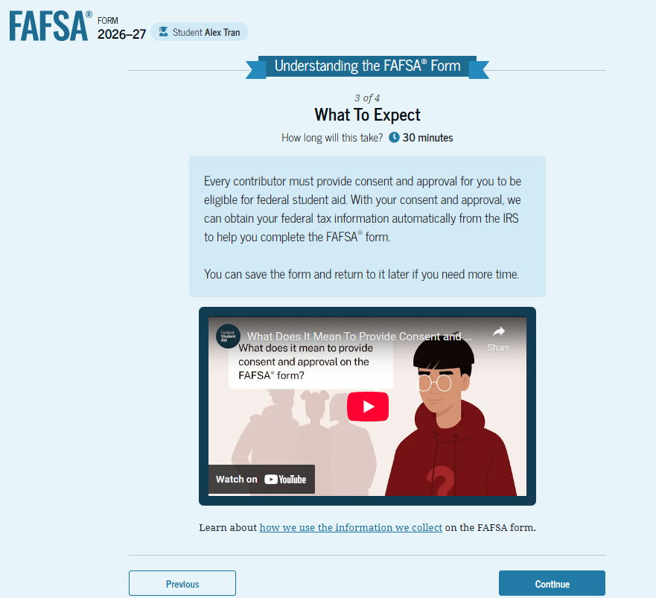
Dependent Student: Onboarding (3 of 4)
The third FAFSA® onboarding page provides information about what the student can expect when completing the FAFSA form. This includes information about consent and approval, a time estimate for completing the form, and a note that the student can save the form and return later if needed, along with an accompanying video.

Slide 24
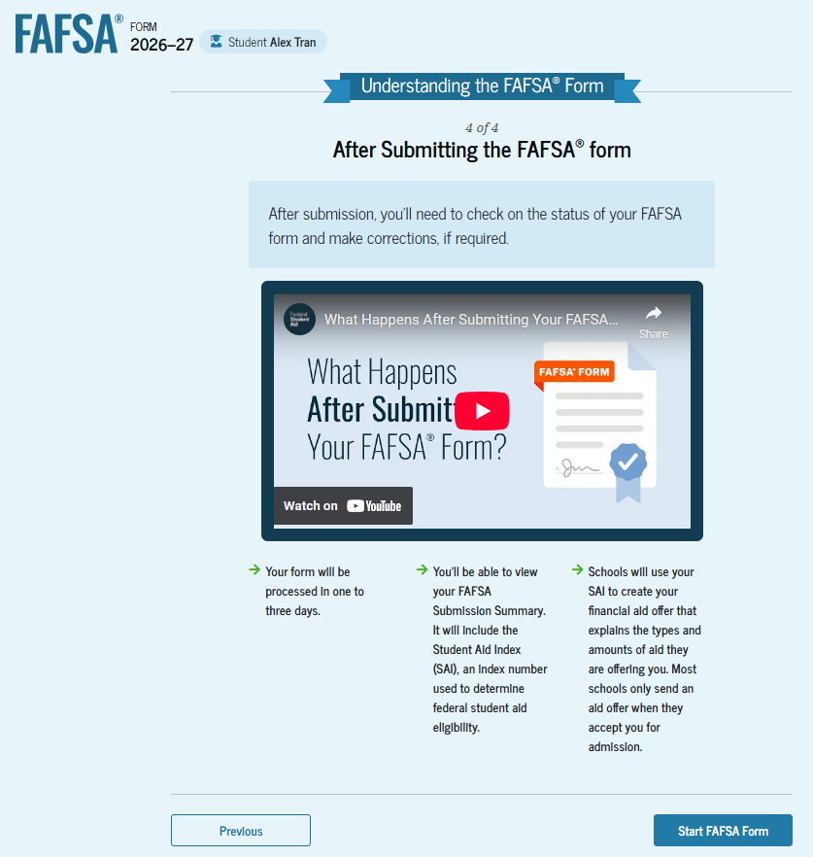
Dependent Student: Onboarding (4 of 4)
The last FAFSA® onboarding page provides information and a video about what to expect once the FAFSA form is completed, submitted, and processed. On this page, the student can select "Start FAFSA Form" to begin.

Slide 25
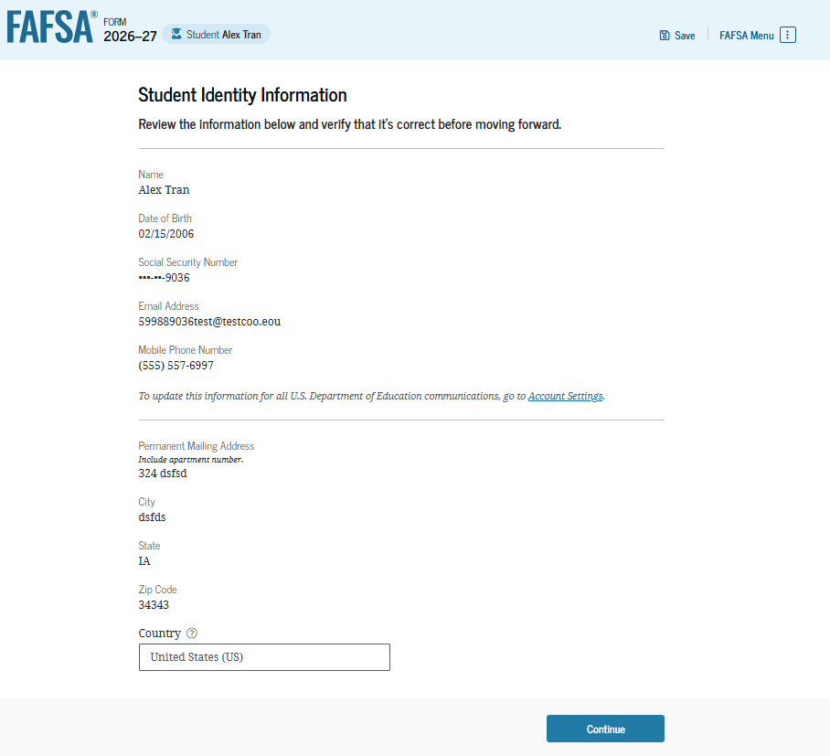
Dependent Student: Student Identity Information
This is the first page within the student section. The student can verify that the personal information is correct. To update any of the personal information, the student must access their account settings on StudentAid.gov.

Slide 26
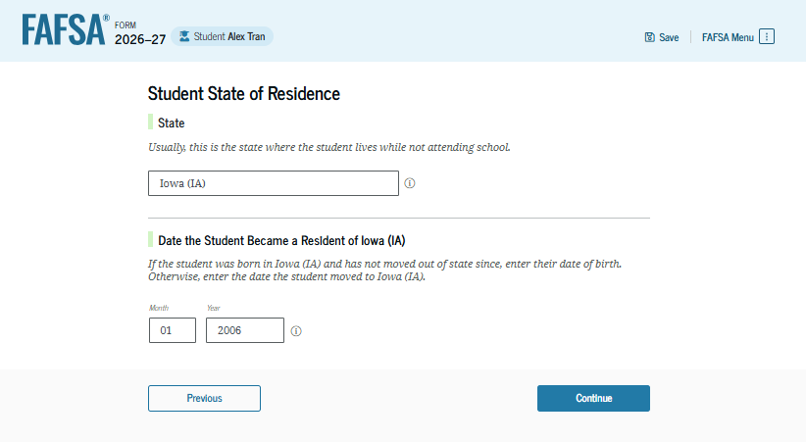
Dependent Student: State of Residence
The student is asked about their state of residence. The student selects the state from a drop-down box and provides the month and year when they became a resident.
NOTE: THE WORD LEGAL HAS BEEN REMOVED

Slide 27
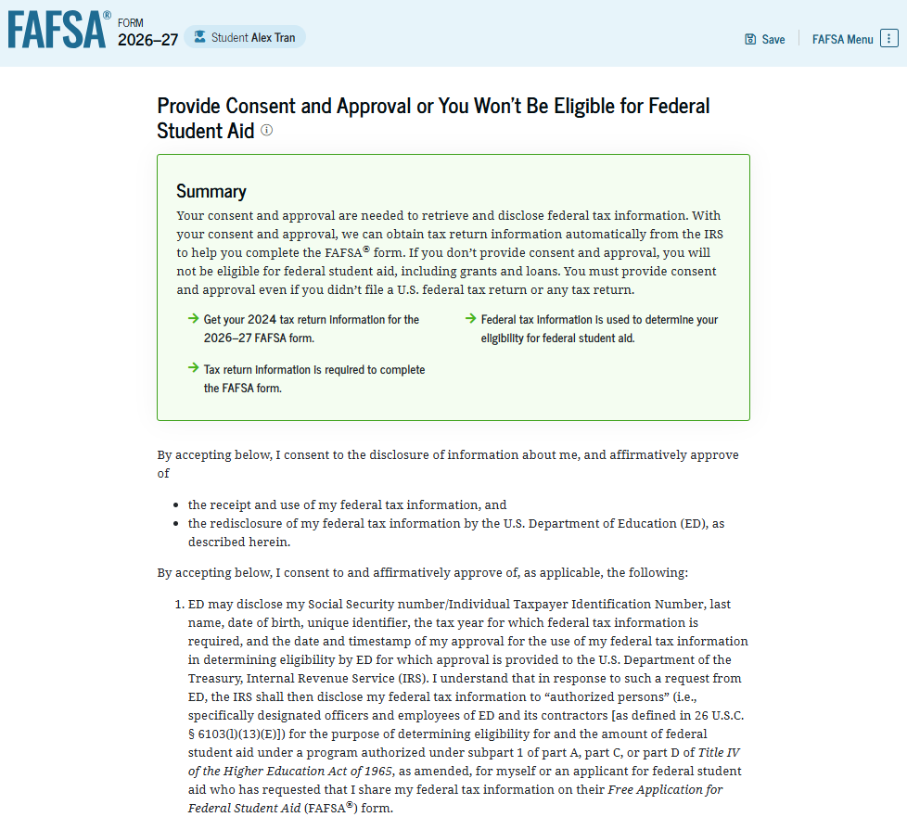
Dependent Student: Provide Consent and Approval
This page informs the student about consent, approval, and the use of federal tax information. Once the student provides consent and approval, their federal tax information is transferred directly from the IRS into the FAFSA® form to help complete the "Your Finances" section.

Slide 28
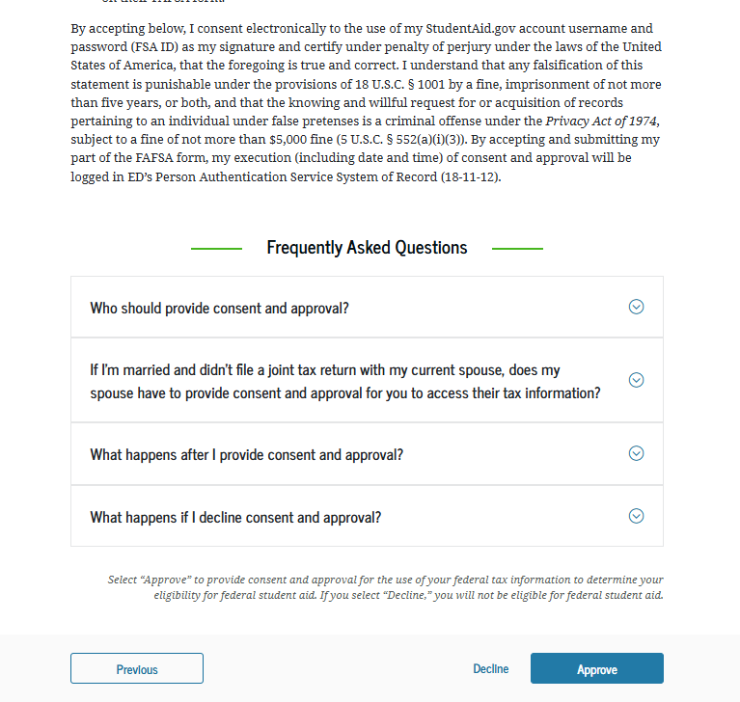
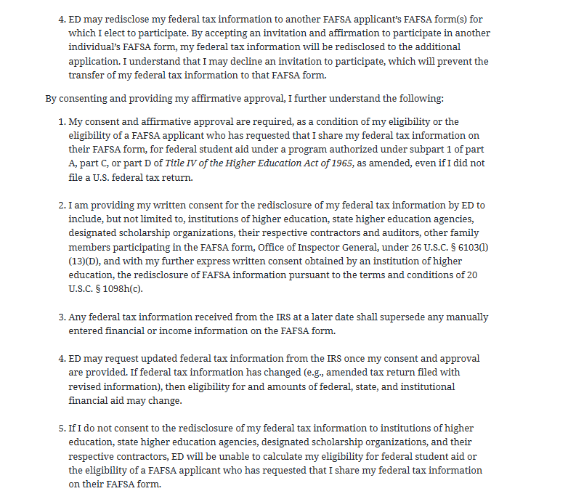
Dependent Student: Provide Consent and Approval (Continued)
This is a continuation of the consent and approval page. The student can expand and collapse FAQs about consent and approval. The student selects "Approve" to provide consent and approval and is taken to the next page.

Slide 29
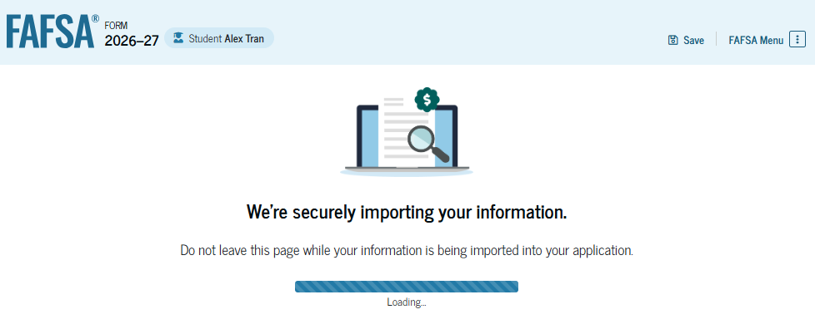
Dependent Student: Imports IRS Information
This page imports the student’s federal tax information by directly transferring it from the IRS into the FAFSA® form to help complete the "Your Finances" section.

Slide 30
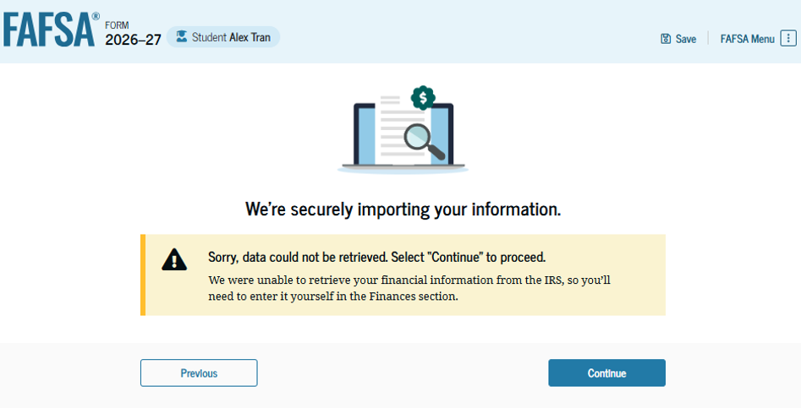
Dependent Student: Imports IRS Information (Continued)
This page displays the results from the IRS import for the student. For this scenario, the student is starting a new FAFSA® form and there is no federal tax information available from the IRS.

Slide 31
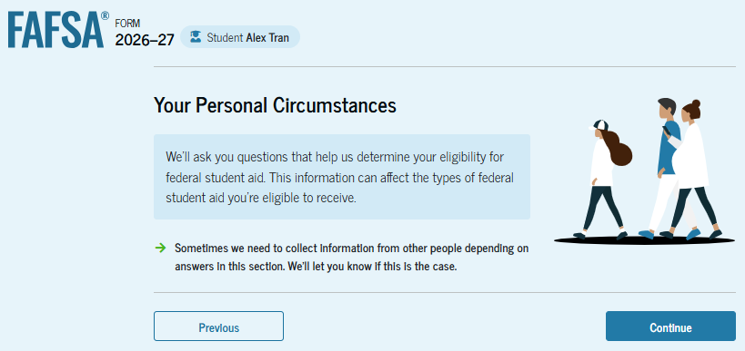
Introduction: Dependent Student Personal Circumstances
This is the first page within the "Your Personal Circumstances" section. It provides an overview of the section.

Slide 32
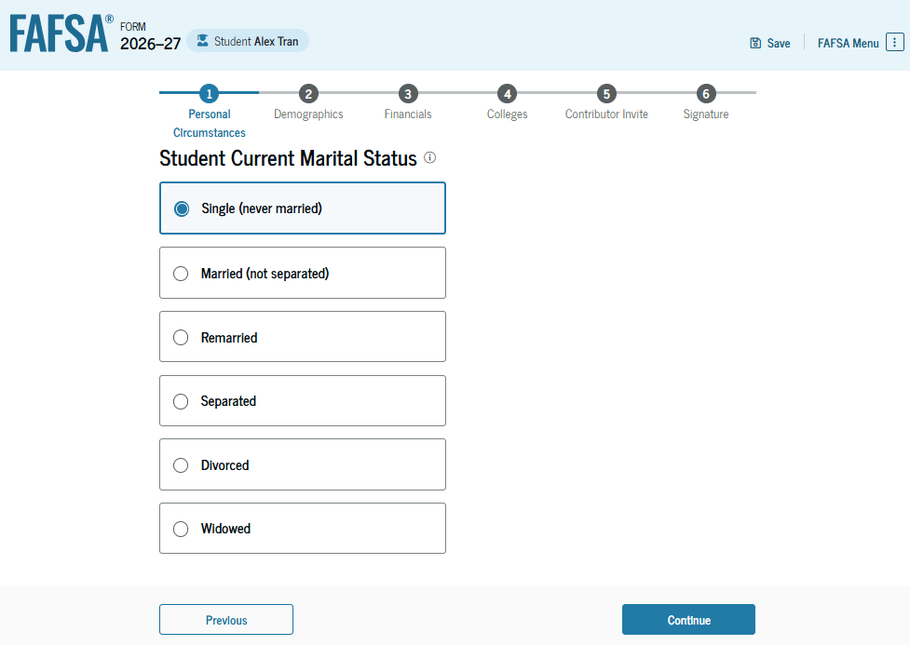
Dependent Student: Marital Status
The student is asked about their marital status. The student selects the "Single (never married)" option.

Slide 33
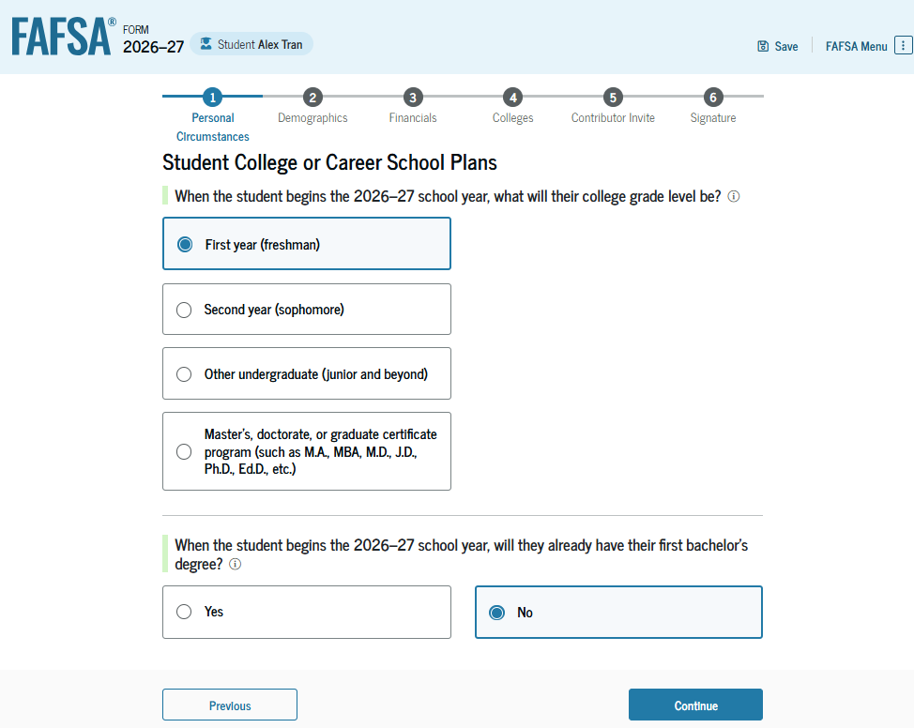
Dependent Student: College or Career School Plans
The student is asked about their college grade level for the 2026–27 school year and if the student will have their first bachelor’s degree. The student selects "First year (freshman)" and "No" to the question about the student’s first bachelor’s degree.

Slide 34
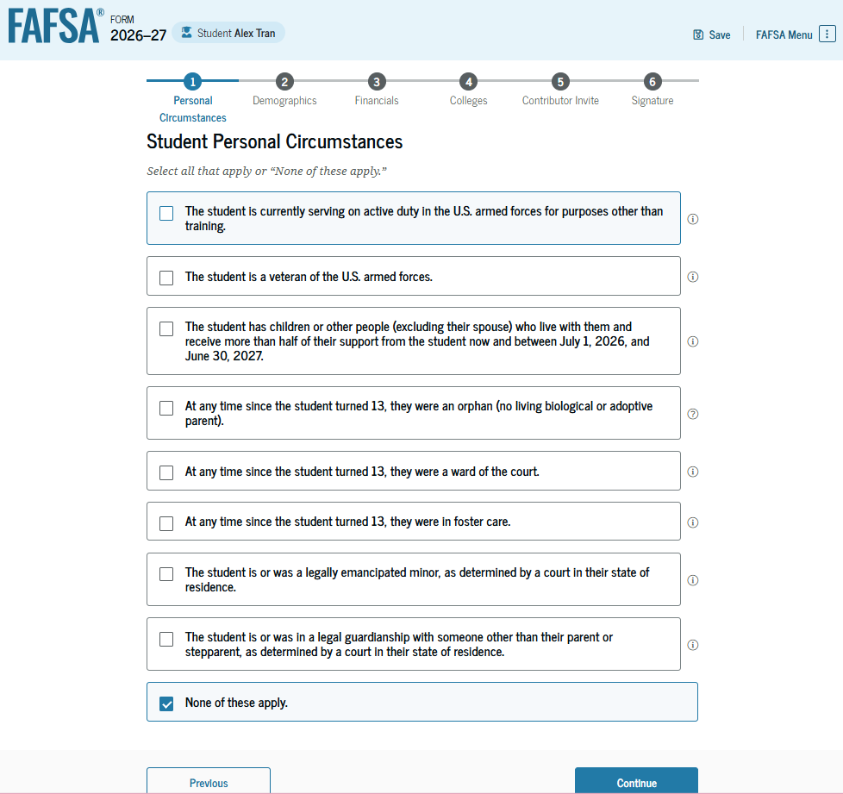
Dependent Student: Personal Circumstances
The student is asked if any of the listed personal circumstances apply. The student selects "None of these apply."

Slide 35
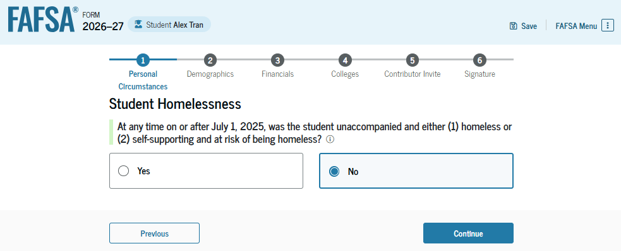
Dependent Student: Homelessness Status
The student is asked if they were homeless or at risk of being homeless. The student selects "No."

Slide 36
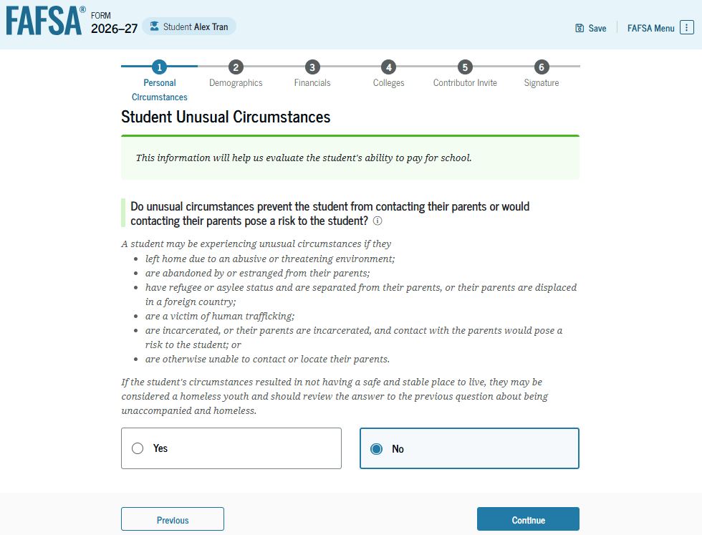
Dependent Student: Unusual Circumstances
The student is asked if unusual circumstances prevent them from contacting the student’s parent(s). The student selects "No."

Slide 37
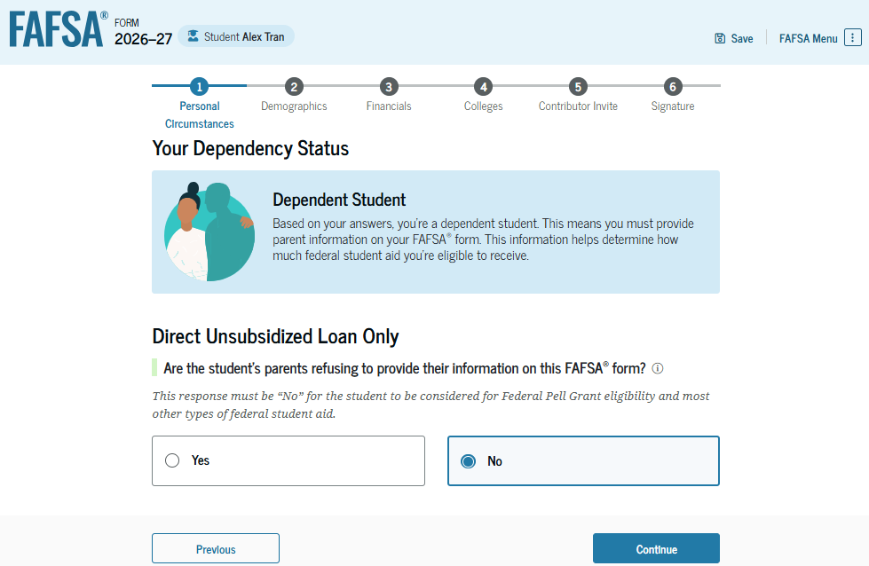
Student Dependency Status: Dependent Student
Based on the answers provided by the student, the student is considered a dependent student. The student is asked if a financial aid administrator should determine their eligibility for a Direct Unsubsidized Loan only. This is an option if the student’s parents are unwilling to provide information. The student selects "No." If the student had selected "Yes," a modal would appear to warn about missing out on other potential federal student aid.

Slide 38
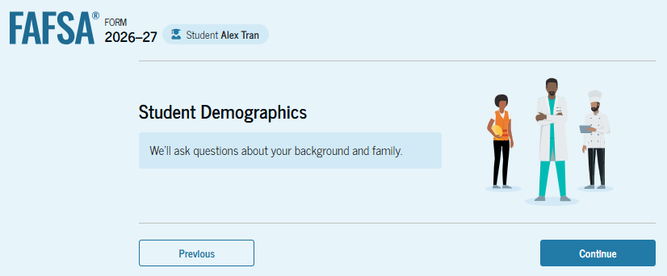
Introduction: Dependent Student Demographics
This is the first page within the "Student Demographics" section. It provides an overview of the section.

Slide 39
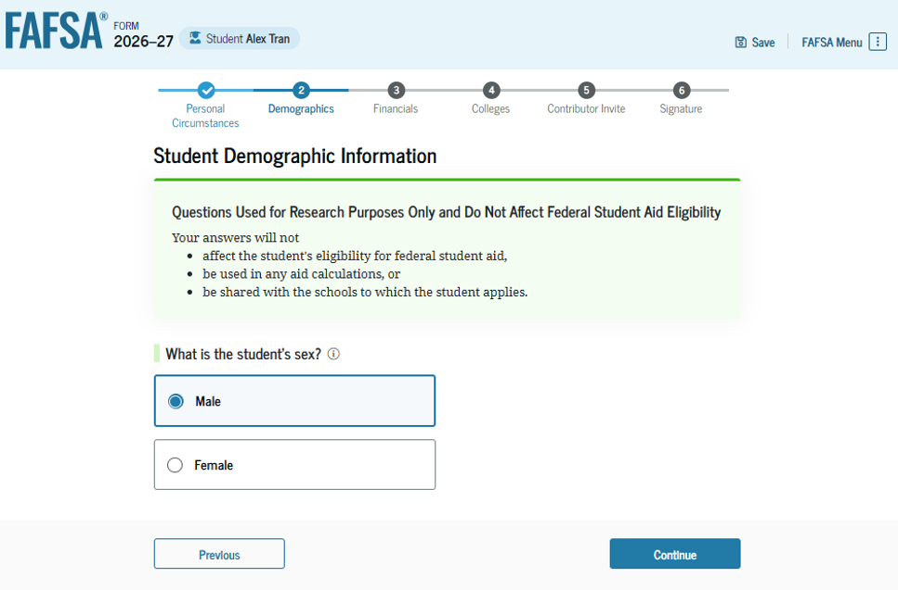
Dependent Student: Demographic Information
The student is asked to identify their sex. This student selects "Male."

Slide 40
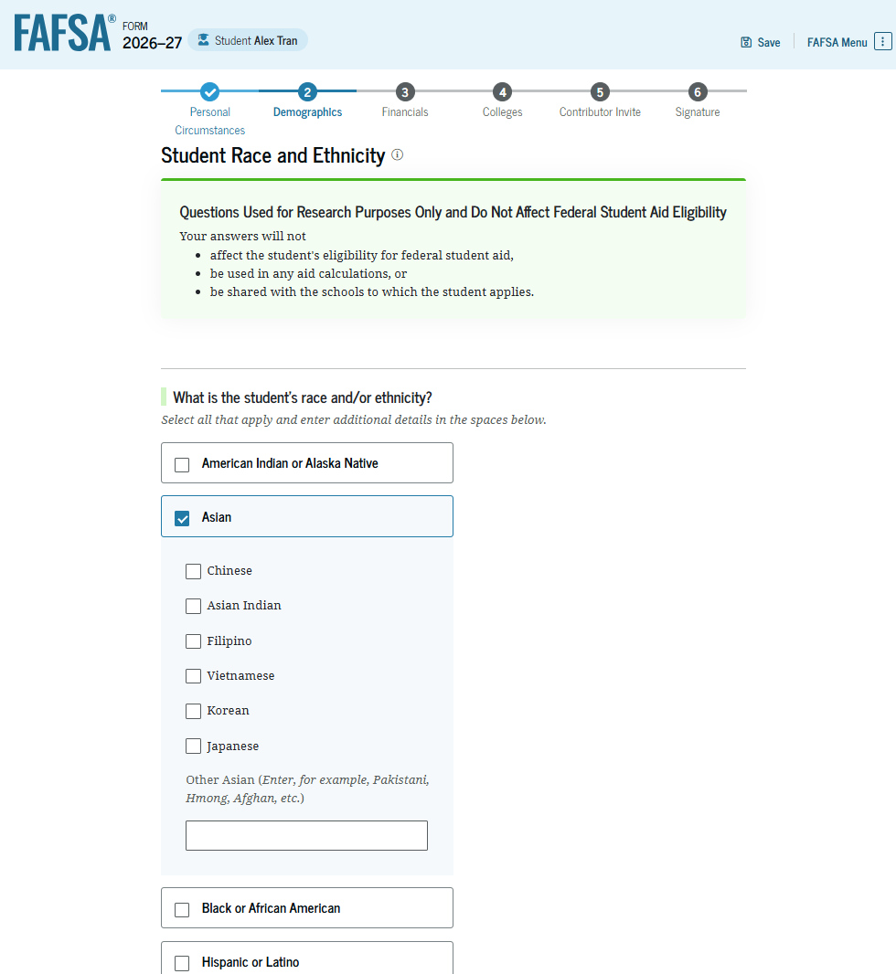
Dependent Student: Race and Ethnicity
The student is asked to identify their race. The student selects the checkboxes that apply. After making a selection, a second drop-down box appears, and the student selects the checkboxes that apply to them.

Slide 41
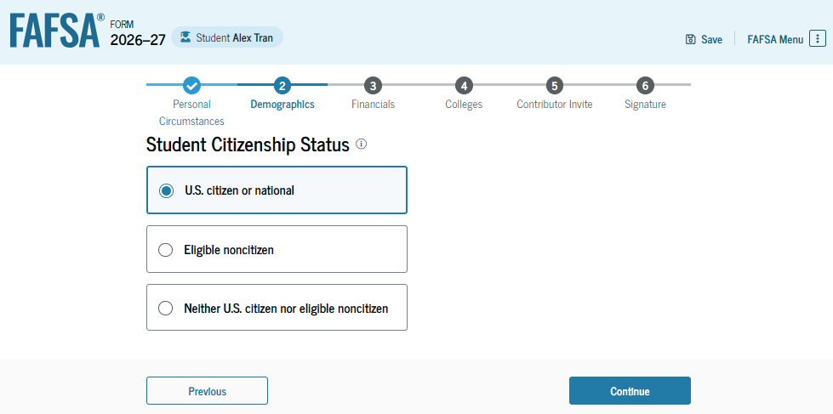
Dependent Student: Citizenship Status
The student is asked about their citizenship status. The student selects the "U.S. citizen or national" option.

Slide 42
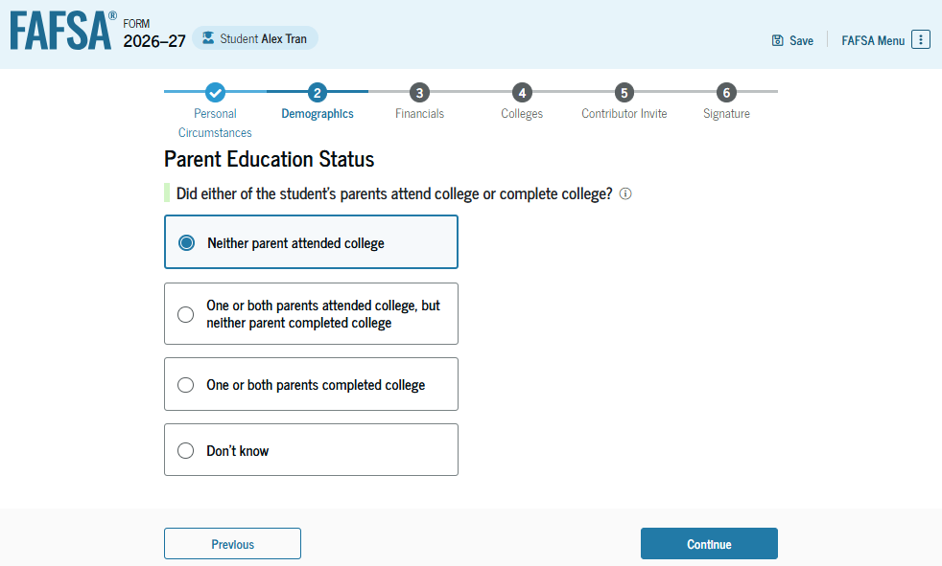
Dependent Student: Parent Education Status
The student is asked about their parents’ education status. The student selects the "Neither parent attended college" option.

Slide 43
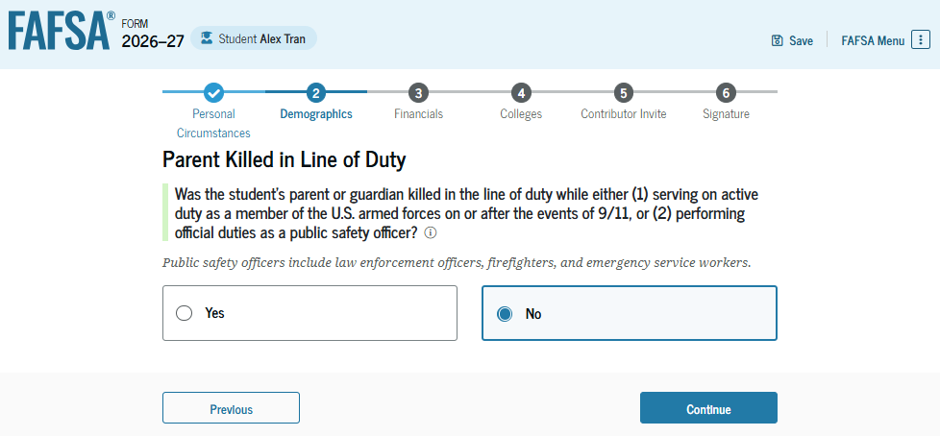
Dependent Student: Parent Killed in Line of Duty
The student is asked if their parent was killed in the line of duty. The student selects the "No" option.

Slide 44
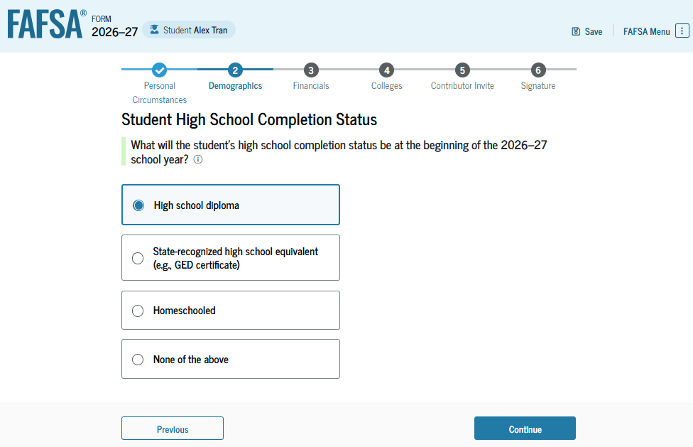
Dependent Student: High School Completion Status
The student is asked about what their high school completion status will be when the student starts the 2026–27 school year. The student selects the "High school diploma" option.

Slide 45
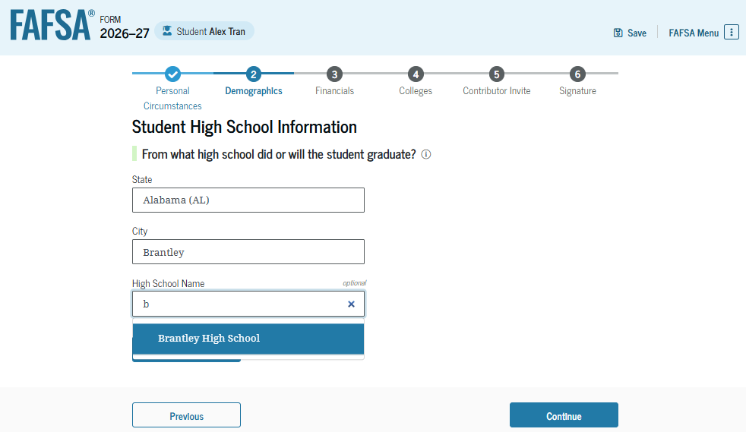
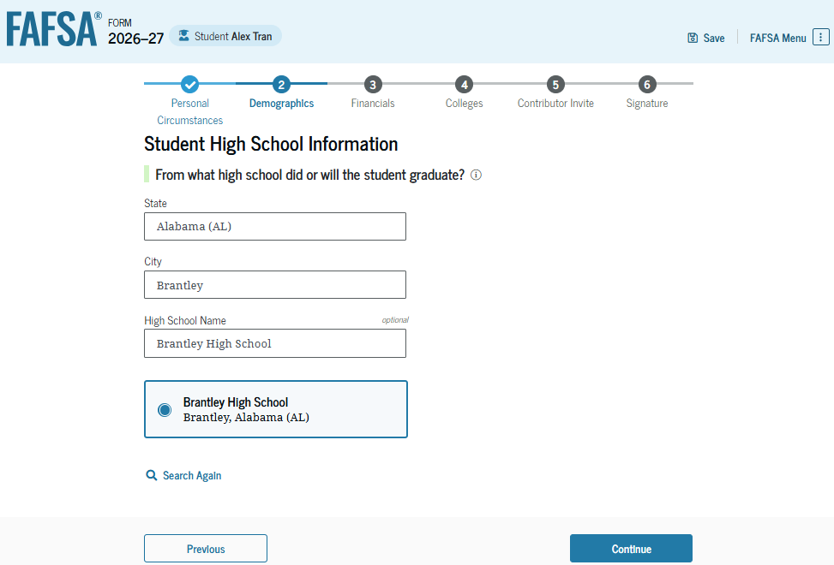
Dependent Student: High School Information
Because the student selected high school diploma, the student is asked to select which high school they did or will graduate from. The student enters the high school’s state and city. After selecting "Search," the student selects the correct high school from the search results.

Slide 46
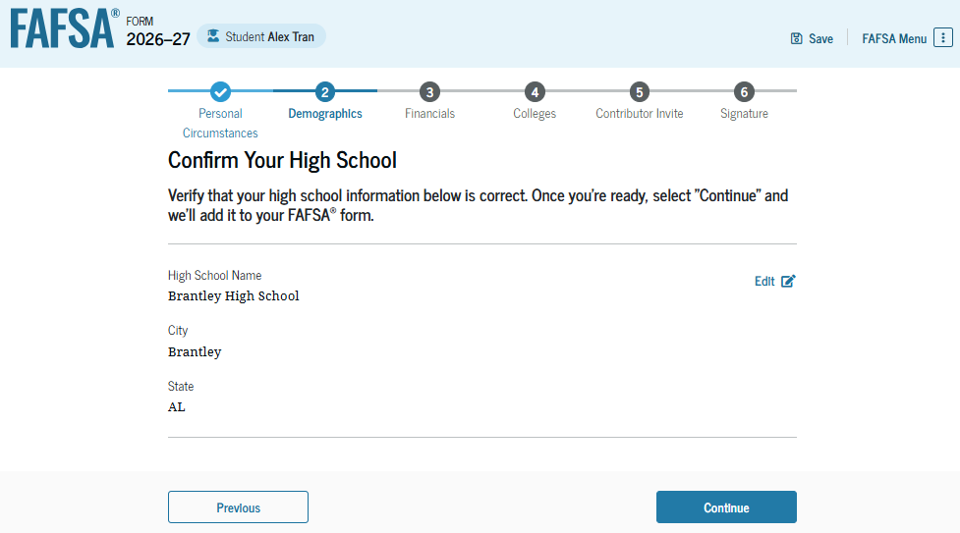
Dependent Student: Confirm High School
The student has the option to edit the high school information presented on this page by selecting "Edit," which will return the student to the high school information page. The student confirms the high school information and selects "Continue" to proceed to the next section.

Slide 47
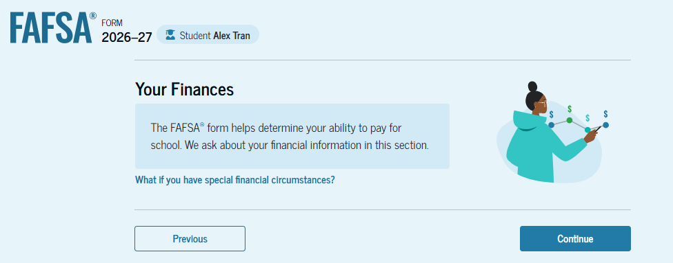
Introduction: Dependent Student Financials
This is the first page within the "Your Finances" section. It provides an overview of the section. The student can select the hyperlink to learn about special financial circumstances.

Slide 48
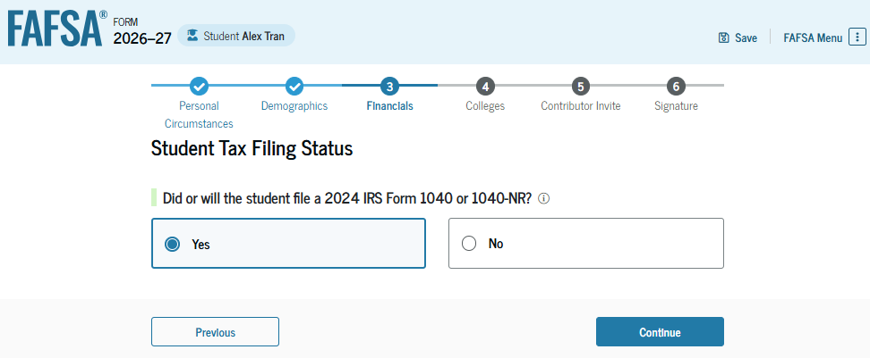
Dependent Student: Tax Filing Status
The student is asked about their tax filing status. The student selects "Yes" to "Did or will the student file a 2024 IRS Form 1040 or 1040-NR?"

Slide 49
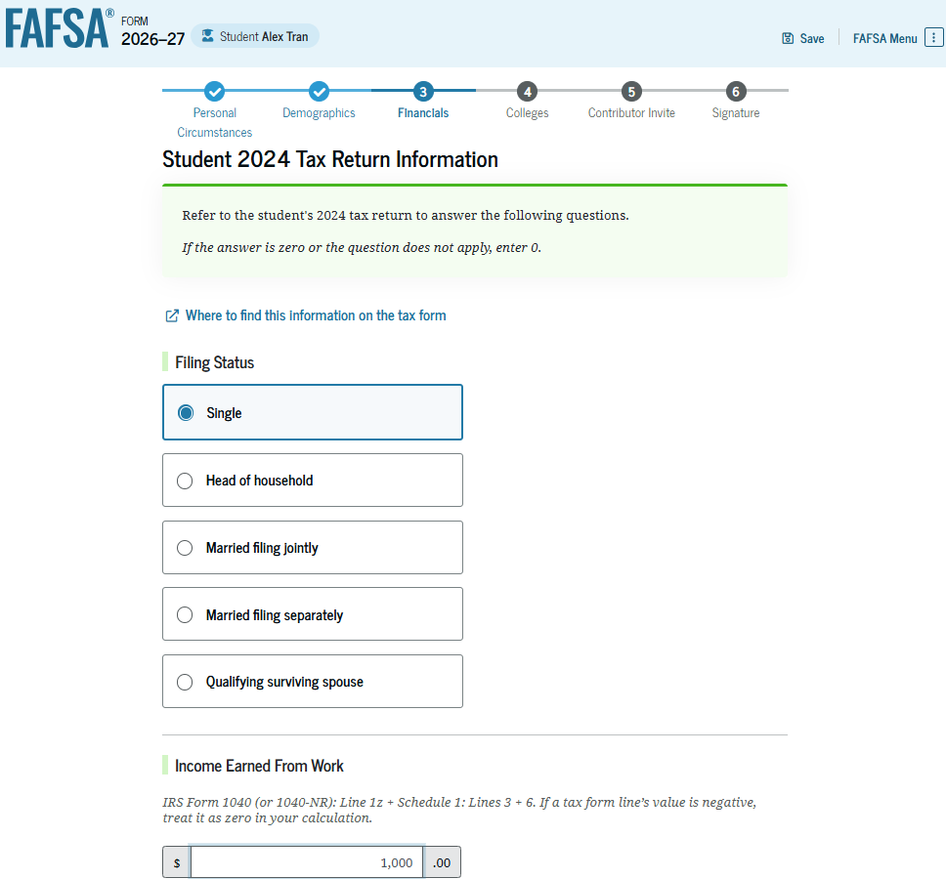
Dependent Student: Tax Return Information
The student is asked about their 2024 tax return. The student selects "Single" as the filing status and enters dollar amounts in the other required responses.

Slide 50
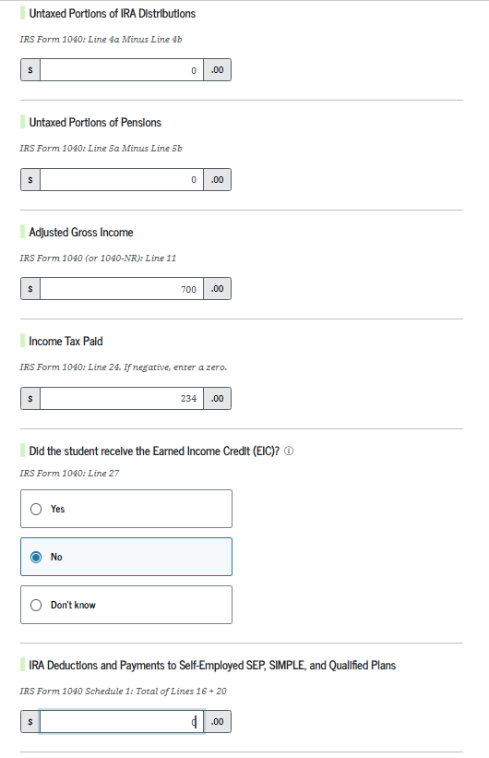
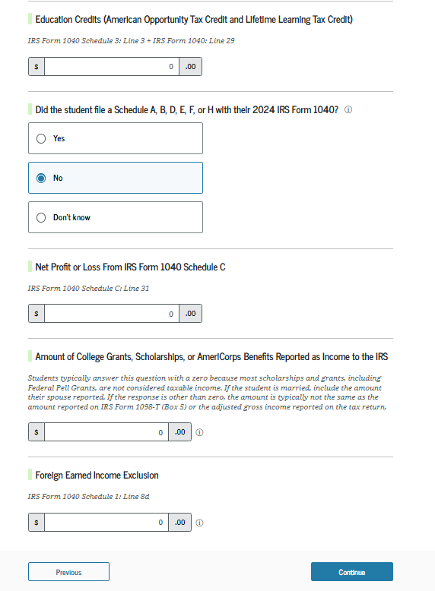
Dependent Student: Tax Return Information (Continued)
The student is asked about their taxes, income, and other financial information. The student enters dollar amounts in the responses. If the student has nothing to report, the student enters the numeral zero.

Slide 51
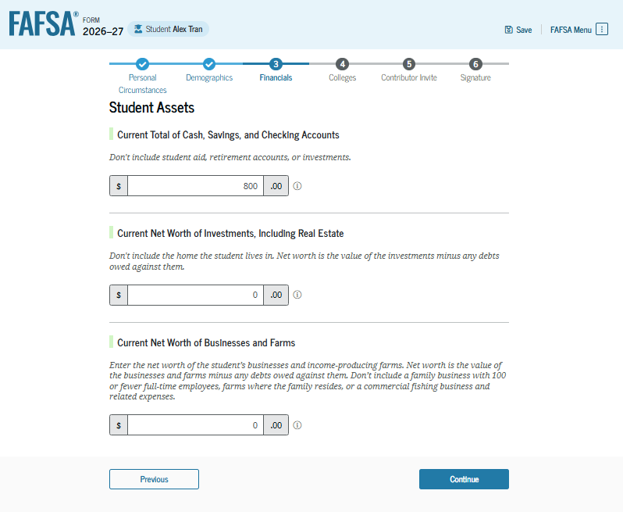
Dependent Student: Assets
The student is asked about their assets. The student enters a response in each entry field. If the student has nothing to report, the student enters the numeral zero.
PLEASE NOTE: THE HELP TEXT HAS BEEN UPDATED TO INCLUDE THE ASSET EXEMPTIONS THAT HAVE RETURNED TO THE FORM

Slide 52
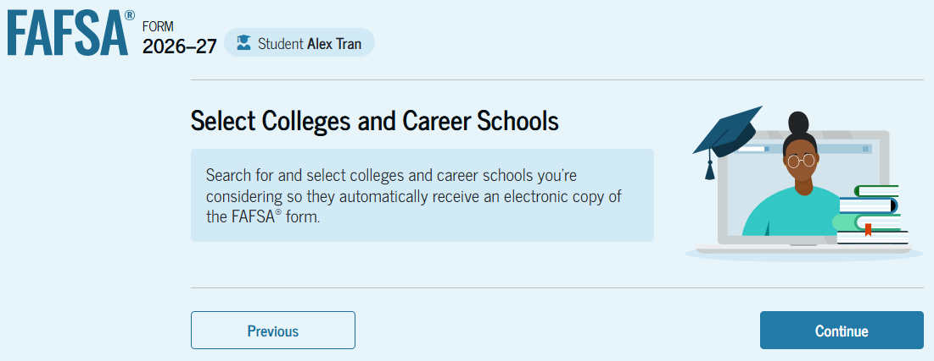
Introduction: Dependent Student Select Colleges
This is the first page in the "Select Colleges and Career Schools" section. It provides an overview of the section.

Slide 53

Dependent Student: College Search
The student is asked to search for the colleges, career schools, or trade schools that will receive their FAFSA® information. The student searches for a school by selecting the state from the drop-down menu and selecting "Search." If the student can’t find a school searching by state, the student can search by school code.

Slide 54

Dependent Student: College Search (Continued)
After entering a school’s state and selecting "Search," the student selects the correct school(s) from the search results. Students can send their FAFSA® information to a maximum of 20 schools. The student must add at least one school to continue.

Slide 55

Dependent Student: Selected Colleges
After the student selects the correct school(s) from the search results, the student can review the school(s) chosen before continuing. If 20 schools have not been selected, the student has the option to search and select more schools, and, in some states, the student has the option to reorder the list of selected schools.

Slide 56

Introduction: Dependent Student Invites Contributor
This is the first page in the "Invite a Parent as a Contributor" section, which is the last student section to require information. It provides an overview of the section.

Slide 57


Dependent Student: Invite Contributor (Continued 1 of 2)
The student is asked to enter their parent’s email address to invite the parent to the FAFSA® form. After entering the email address, the student selects "Send Invite." A pop-up window appears, and the student confirms their parent’s email address by selecting "Send Invite."

Slide 58

Dependent Student: Invite Contributor (Continued 2 of 2)
This page confirms the student’s parent will receive an email inviting them to the student’s FAFSA® form. The parent can access the form by accepting the invitation in the email. On this page, the student is also provided an invitation link and invitation code that can be shared directly with the parent.

Slide 59

Dependent Student: Review Page
The review page displays the responses that the student has provided in the FAFSA® form. The student can view all responses by selecting "Expand All" or expand each section individually. To edit a response, the student can select the question’s hyperlink to be taken to the corresponding page.

Slide 60

Dependent Student: Signature
On this page, the student reviews the terms and conditions of the FAFSA® form and what they’ll agree to when the student signs the form.

Slide 61

Dependent Student: Signature (Continued)
This is a continuation of the student signature page. After agreeing to the terms and conditions of the FAFSA® form and digitally signing, the student is able to submit their sections of the FAFSA form. Since parent information has not been provided, the FAFSA form is not considered complete and can’t be processed yet.

Slide 62

Dependent Student: Section Complete
Upon digitally signing the student section, the student is presented with the "Pending Submission" page. The student is reminded that their FAFSA® form is not completed and can’t be submitted until the parent completes the contributor section of the form and signs it. This page also displays next steps the student can take, including tracking and managing their form.

Slide 63
Dependent Student Parent Section

Slide 64


Dependent Student: Parent Email
This is NOT a view within StudentAid.gov or the FAFSA® form. This view demonstrates a parent opening the FAFSA invitation from their email. The parent selects "Accept Invitation" and is taken to StudentAid.gov.

Slide 65


Dependent Student: Parent Log-in
The parent is taken from their email to the "Log In" page to enter their credentials. To access the FAFSA® form, all users are required to have a StudentAid.gov account username and password. If the parent doesn't have a username and password, they can select "Create an Account."

Slide 66

Dependent Student: Parent Accepts Invitation
After logging in, the parent is taken to the "Accept 2026–27 FAFSA® Invitation" page. The invitation code from the parent’s email automatically fills in the text box if the parent used the link from the email.

Slide 67

Dependent Student: Parent Accepts Invitation (Continued)
When the parent selects "Submit," a pop-up window appears, confirming the student’s name and reminding the parent that their personal information is needed to fill out the student’s FAFSA® form. The parent selects "Accept" to agree to sharing their information and enters the FAFSA form.

Slide 68

Dependent Student: Parent Onboarding (1 of 4)
When the parent enters a 2026–27 FAFSA® form for the first time, they are taken through the FAFSA onboarding process. The first onboarding page provides an introduction of the FAFSA form and an accompanying video.

Slide 69

Dependent Student: Parent Onboarding (2 of 4)
The second FAFSA® onboarding page provides information and a video about contributors that may be required to participate on the student’s FAFSA form. This page also provides information on how the parent will invite contributors to the FAFSA form.

Slide 70

Dependent Student: Parent Onboarding (3 of 4)
The third FAFSA® onboarding page provides information about what the parent can expect when completing the student’s FAFSA form. This includes information about consent and approval, a time estimate to complete the form, and a note that the parent can save the form and return later if needed, along with an accompanying video.

Slide 71

Dependent Student: Parent Onboarding (4 of 4)
The last onboarding page provides information and a video about what to expect once the FAFSA® form is completed, submitted, and processed. On this page, the parent selects "Start FAFSA Form" to begin the parent section.

Slide 72

Dependent Student: Parent Identity Information
This is the first page within the parent section. The parent can verify that the personal information is correct. To update any of the personal information, the parent must access their account settings on StudentAid.gov.

Slide 73

Dependent Student: Parent Identity Information
(Continued)
This is a continuation of the first page within the parent section. The parent can verify their mailing address on this part of the page. To update this information, the parent must access their account settings on StudentAid.gov.

Slide 74

Dependent Student: Parent Provides
Consent and Approval
This page informs the parent about consent, approval, and the use of their federal tax information. Once the parent provides consent and approval, their federal tax information is transferred directly from the IRS into the FAFSA® form to help complete the "Parent Finances" section.

Slide 75


Dependent Student: Parent Provides Consent and Approval (Continued)
This is a continuation of the consent and approval page. The parent can expand and collapse FAQs about consent and approval. The parent selects "Approve" to provide consent and approval and is taken to the next page.

Slide 76

Dependent Student: Parent Imports IRS Information
This page imports the parent’s federal tax information by directly transferring it from the IRS into the FAFSA® form to help complete the "Parent Finances" section.

Slide 77

Dependent Student: Parent Imports IRS Information (Continued)
This page displays the results from the IRS import for the parent. For this scenario, the parent is contributing to a new FAFSA® form and there is no federal tax information available from the IRS.

Slide 78

Introduction: Dependent Student’s Parent Demographics
This is the first page in the "Parent Demographics" section. It provides an overview of the section.

Slide 79

Dependent Student: Parent Current Marital Status
The parent is asked about their current marital status. The parent selects the "Married (not separated)" option.

Slide 80

Dependent Student: Parent State of Residence
The parent is asked about their state of residence. The parent selects the state from a drop-down box and provides the month and year when the parent became a resident.
PLEASE NOTE: THE WORD LEGAL HAS BEEN REMOVED

Slide 81

Introduction: Dependent Student’s Parent Finances
This is the first page within the "Parent Finances" section. It provides an overview of the section. The parent can select the hyperlink to learn about special financial circumstances.

Slide 82

Dependent Student: Parent Federal Benefits Received
This page asks the parent if the parent or anyone in the parent’s family has received federal benefits. The parent selects "None of these apply."

Slide 83

Dependent Student: Parent Tax Filing Status
This page asks the parent about their tax filing status. The parent selects "Yes" to "Did or will the parent file a 2024 IRS Form 1040 or 1040-NR?" and "Yes" to "Did or will the parent file a 2024 joint tax return with their current spouse?"

Slide 84

Dependent Student: Parent Family Size
This page displays the family size for the student. The parent has the option to enter the number of children or other dependents who live with the parent and will receive more than half of their support from the parent between July 1, 2026, and June 30, 2027.

Slide 85

Dependent Student: Parent Number in College
This page asks the parent how many people in the family will be in college between July 1, 2026, and June 30, 2027. The parent enters a response into the entry field.

Slide 86


Dependent Student: Parent Tax Return Information
The parent is asked questions about their 2024 tax return. The parent enters a response in each entry field. If the parent has nothing to report, the parent enters the numeral zero.

Slide 87

Dependent Student: Parent Assets
The parent is asked about their assets. The parent enters a response in each entry field. If the parent has nothing to report, the parent enters the numeral zero.
PLEASE NOTE: THE HELP TEXT IS UPDATED TO REFLECT THE NEW EXEMPTIONS

Slide 88

Dependent Student: Other Parent Information
The parent is asked to provide information about their spouse or partner. In this example, the other parent does not need to contribute to the student’s FAFSA® form because the parents filed taxes jointly. After providing the other parent’s date of birth, all required parent information will be complete.

Slide 89

Dependent Student: Parent Review Page
The review page displays the responses that the parent has provided in the FAFSA® form. The parent can view responses only within the parent section of the student’s FAFSA form. The parent can view all the responses by selecting "Expand All" or expand each section individually. To edit a response, the parent can select the question’s hyperlink to be taken to the corresponding page.

Slide 90

Dependent Student: Parent Signature
On this page, the parent acknowledges the terms and conditions of the FAFSA® form and digitally signs the parent section. Since all required sections are complete, the parent can both sign and submit the student’s FAFSA form.

Slide 91

Dependent Student: Parent Confirmation
Upon submitting the student’s FAFSA® form, the parent is presented an abbreviated confirmation page. This page displays information about tracking the student’s FAFSA form and next steps. The student will receive an email with the full, detailed confirmation. With the student and parent sections completed and signed, the FAFSA form is now considered complete and submitted for processing.

Slide 92
FAFSA Submission Summary

Slide 93

FAFSA Submission Summary Landing Page
The student receives a FAFSA Submission Summary for their processed FAFSA® form and any subsequent corrections that the student submits. The FAFSA Submission Summary is divided into four tabs: "Eligibility Overview," "FAFSA Form Answers," "School Information," and "Next Steps." At the top, the student will see when the FAFSA form was received and processed. The student also has the option to print the FAFSA Submission Summary to keep for their records.

Slide 94

Eligibility Overview
On the "Eligibility Overview" tab, the student sees information about the federal student aid for which they may be eligible, such as a Federal Pell Grant and Federal Direct Loans. Any amounts of financial aid that display on this tab are estimates and are not guaranteed. The school's financial aid office provides final determination of the student’s financial aid eligibility.

Slide 95

Eligibility Overview (Continued)
This is a continuation of the "Eligibility Overview" tab of the FAFSA Submission Summary. The student can view their Student Aid Index. The school's financial aid office provides final determination of the student’s financial aid eligibility.

Slide 96

FAFSA® Form Answers
On the "FAFSA Form Answers" tab, the student sees the answers provided on their FAFSA® form. If any of the provided answers are incorrect, the student can choose "Make a Correction."

Slide 97

FAFSA® Form Answers (Continued)
This is a continuation of the "FAFSA Form Answers" tab, where the student sees the answers provided on their FAFSA® form.

Slide 98


FAFSA ® Form Answers Contributors
This is a continuation of the "FAFSA Form Answers" tab. If applicable, the student sees the answers their contributor(s) provided on the FAFSA® form.

Slide 99

School Information
On the "School Information" tab, the student sees information about the college(s), career school(s), and/or trade school(s) they selected to receive their FAFSA® information. The student can view graduation rate, retention rate, transfer rate, default rate, median debt upon completion, and average annual cost of the selected school(s).

Slide 100

Next Steps
On the "Next Steps" tab, the student sees comments that pertain to their FAFSA® form. Some comments may require the student to make a correction or send additional documentation to their school. Other comments may be informational and require no action from the student.

Slide 101

More Resources
Lastly, along the right side of the FAFSA Submission Summary, the student can access additional resources, including links to "My Aid" or College Scorecard.

Slide 102
FSA Fafsa resources
Studentaid.gov Account/FSA ID: https://studentaid.gov/fsa-id/create-account/launch
FAFSA Form: https://studentaid.gov/h/apply-for-aid/fafsa
Financial Aid Toolkit(Training Resources & Handouts): https://financialaidtoolkit.ed.gov/tk/
FSA Knowledge Center/FAFSA Simplification: https://fsapartners.ed.gov/knowledge-center/topics/fafsa-simplification-information
FAFSA Prototype: 2026–27 FAFSA Prototype Now Available | Federal Student Aid - Financial Aid Toolkit
Federal Student Aid Estimator: https://studentaid.gov/aid-estimator/

Slide 103
NCAN FAFSA RESOURCES-available 8/18/25
NCAN 2026-2027 FAFSA Resources: 2026-27 FAFSA - National College Attainment Network
FAFSA Tracker: FAFSA Tracker - National College Attainment Network
Today’s Webinar Recording Link: Coming soon
26-27 FAFSA Slack Channel: Sign up here: ncan.org/community
NCAN 2025-2026 FAFSA Resources: 2025-26 FAFSA - National College Attainment Network (currently available)
FAFSA Is Working Webinar: Coming October 2025

Slide 104
QUESTIONS????
Morralee keller
kellerm@ncan.org

